Slide 1

Seasonal Agriculture Performance Analysis
Karan Chakradhari
Dr. C.V. Raman University, Bilaspur ,Chhattisgarh
AICTE STU ID : STU6a1ad8009ca8a1780144128

Slide 2

PROBLEM STATEMENT
(Agricultural activities are influenced by seasonal variations in environmental conditions, farming practices, resource availability and market conditions. As a result, agricultural performance may differ from one season to another. However, raw agricultural data does not clearly explain how agricultural performance changes across seasons or what patterns can be observed in different seasonal conditions. The problem is to analyze the given agricultural dataset and investigate seasonal differences in agricultural performance by identifying meaningful patterns, trends, relationships and variations within the available data.

Slide 3
Project Description
For this project I worked with 4,000 farm records collected across three cropping seasons - Kharif, Rabi and Zaid - covering 8 Indian states and 8 major crops. I used Python (Pandas, NumPy, Matplotlib and Seaborn) inside a Jupyter Notebook to clean up the data first, since rainfall, soil moisture and yield all had a few missing values. Once that was sorted, I looked at how weather, irrigation, soil conditions and input use change from season to season, and how those changes end up affecting yield, cost and profit. I relied mostly on descriptive statistics, correlation analysis and season-wise comparisons to spot patterns, then built visualizations to make everything easier to read. The end goal was to walk away with a few practical, data-backed recommendations for planning farming activity season by season.

Slide 4

WHO ARE THE END USERS?
Farmers deciding which crops and irrigation methods make sense for the season ahead
Extension officers and state agriculture departments shaping seasonal advisories
Input suppliers - fertilizer, seed and irrigation companies - planning seasonal demand
Banks and crop insurance providers gauging how risky a season is before lending
Researchers and students studying seasonal patterns in Indian agriculture
Agri-tech developers building tools that help farmers plan around the season

Slide 5

Technology Used
Python 3 - the main language used for the whole analysis
Pandas & NumPy - for cleaning the data and running the calculations
Matplotlib & Seaborn - for all the charts and visualizations
Jupyter Notebook - to keep the code, output and explanations together in one place
Basic statistics - descriptive stats, correlation checks and season-wise comparisons

Slide 6
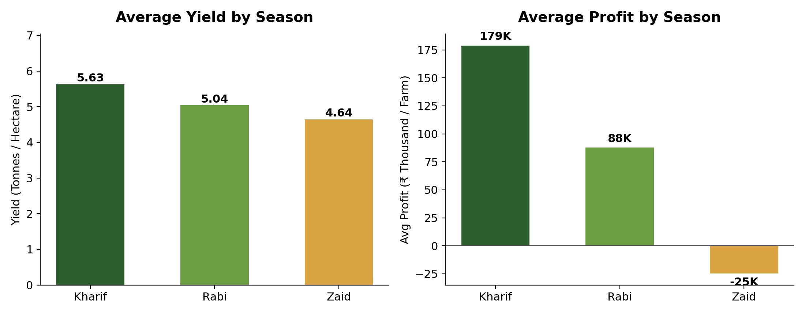
RESULTS
Kharif Is Clearly the Strongest Season
On average, Kharif gives the best yield (5.63 t/ha) and the best profit (₹1.79L). Zaid actually runs at a loss on average - it's the toughest season financially.

Slide 7
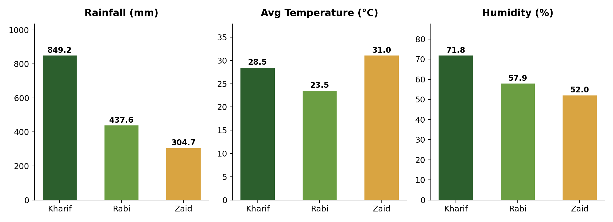
RESULTS
Weather Changes a Lot Between Seasons
Kharif gets far more rain and humidity thanks to the monsoon. Zaid is hotter and drier, which puts a lot more pressure on water availability.

Slide 8
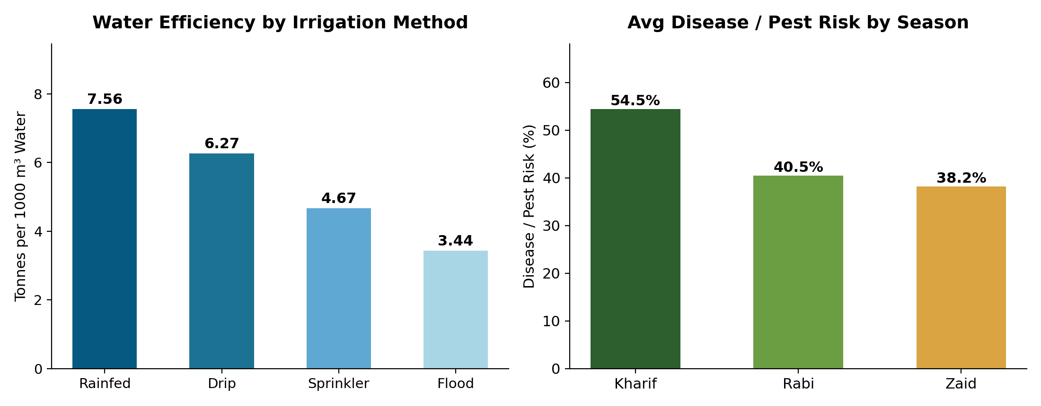
RESULTS
The Irrigation Method You Pick Really Matters
Rainfed and drip irrigation use water far more efficiently than flood irrigation does. Disease and pest risk is also worse in Kharif, likely because of the humidity.

Slide 9
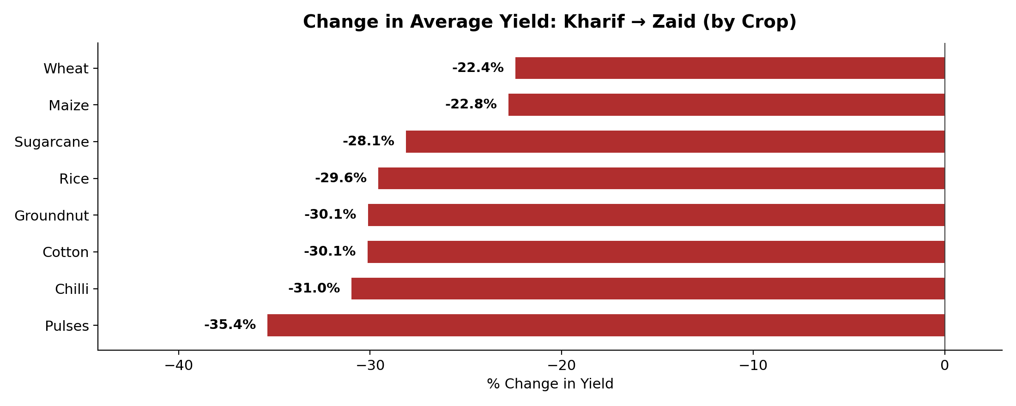
RESULTS
Every Single Crop Does Worse in Zaid
All 8 crops lose yield going from Kharif to Zaid - anywhere from 22% (wheat, maize) to 35% (pulses). It's not a one-off; it shows up across the board.

Slide 10
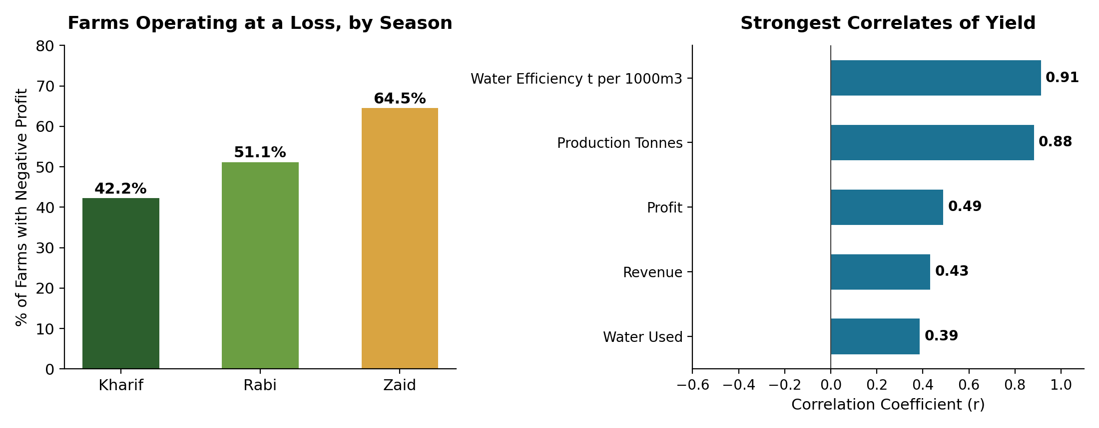
RESULTS
Water Efficiency Matters More Than Anything Else
The share of farms losing money jumps from 42% in Kharif to 65% in Zaid. And of everything checked, water-use efficiency correlates with yield the most (r = 0.91).

Slide 11
Future scope
• Try building a simple ML model that predicts yield or profit from season and weather
• Hook up a live weather API so advisories can update in real time
• Bring in more states and more years of data to see if these patterns hold up over time
• Turn this into an interactive dashboard (Power BI or Streamlit) that farmers could actually use
• Use satellite-based soil moisture data instead of relying on manual readings
• Build a simple crop-recommendation tool based on which crops pay off best each season

Slide 12
GitHub Link
https://github.com/KARAN-112005/Seasonal-Agriculture-Performance-Analysis.git

Slide 13

VOIS Course completion certificate - Course name- Data Visualization

Slide 14
Thank you
.
.

